Slide 1
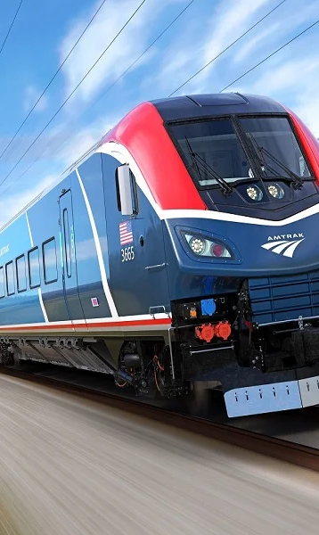
TrainMate A Railway Management System
Presenters:
Hafsah Mehdi - SP22-BCT-016
M. Fahad Malik - SP22-BCT-024

Slide 2
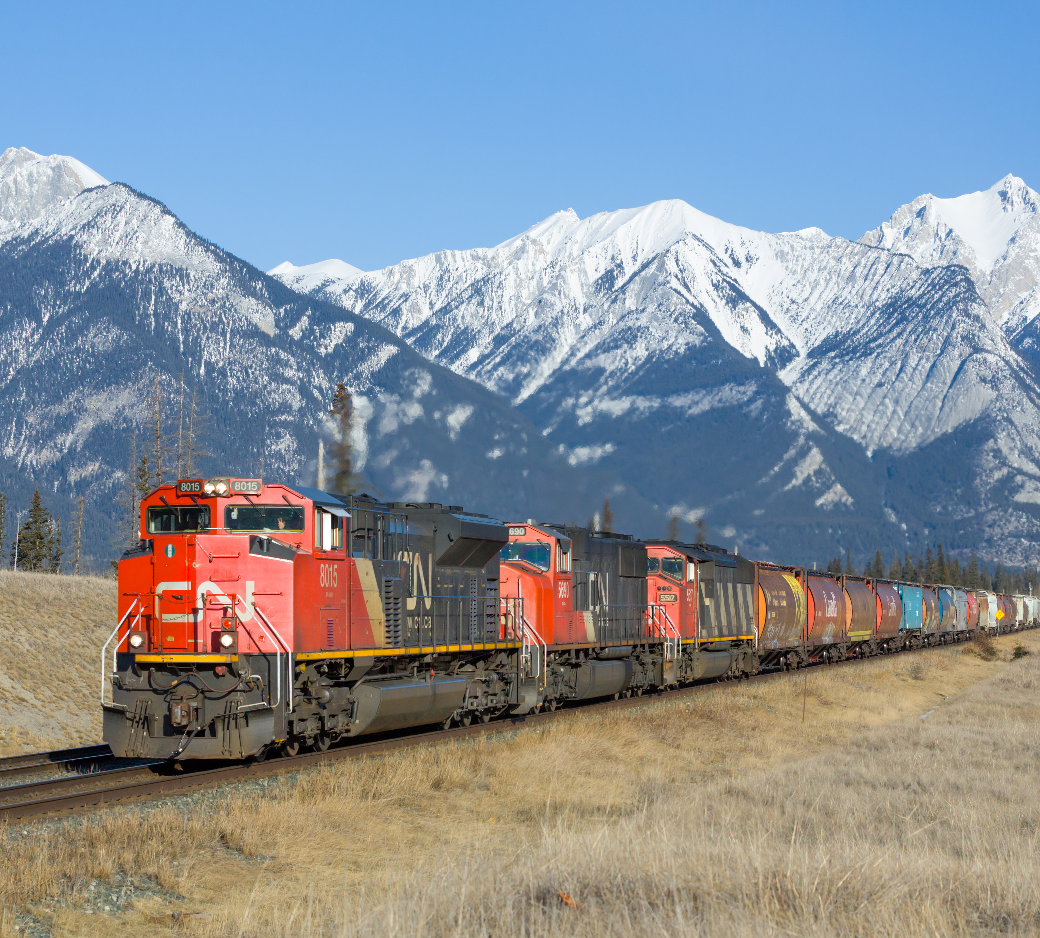
Problem Statement
Problems faced by train management systems:
Manual Processes – paper-based, time consuming, error-prone.
Lack Of Automation- leads to task inefficiencies, resource allocation, cost/time-consuming.
Limit Visibility- No real-time method of looking at the status of trains, resources, passengers etc.

Slide 3
Scope
The proposed project is a train ticketing and scheduling system, called TrainMate, which aims to provide a comprehensive and user-friendly interface for both commuters and administrators. The scope of the project includes the development of a platform that allows users to view train schedules, book tickets, and manage train routes and schedules.
Limitations
Scalability
Limited availability of train schedule data
Integration with existing systems
Security concerns

Slide 4
Table
Data Structures Used | Purpose
Stacks | Manage cars of a Train.
Graphs | Manage Train routes, find routes between stations, depth first search.
Arrays | Used to manage adjacency lists in the graphs.
Queues | Used to manage tickets, FIFO order, to process tickets.
Heaps | Used to manage trains based on their data, such as their capacity, prices etc.
Linked Lists

Slide 5
Algorithms
Dijisktra’s Algorithm: When several routes for a passenger, it can find the shortest route.
Searching: Searching through graph based on specific data.
Sorting: Sorting Trains based on their data such as their capacity, making it easy to keep a record.
DFS: Depth first search for traversing through graph of train routes.

